Slide 1
CSE - 462
Algorithm Engineering
Maximum Cut
1805011 - Kazi Rakibul Hasan
1805021 - Abdus Samee
1805031 - Nahian Shabab
1805035 - Saleh Sakib Ahmed
1805101 - Shahriar Ferdoush Sifat

Slide 2
Topics to cover…
Definition
Polynomial time reductions
Existing algorithms
Implementation experiments
Theoretical and real-world applications

Slide 3
Definition

Slide 4
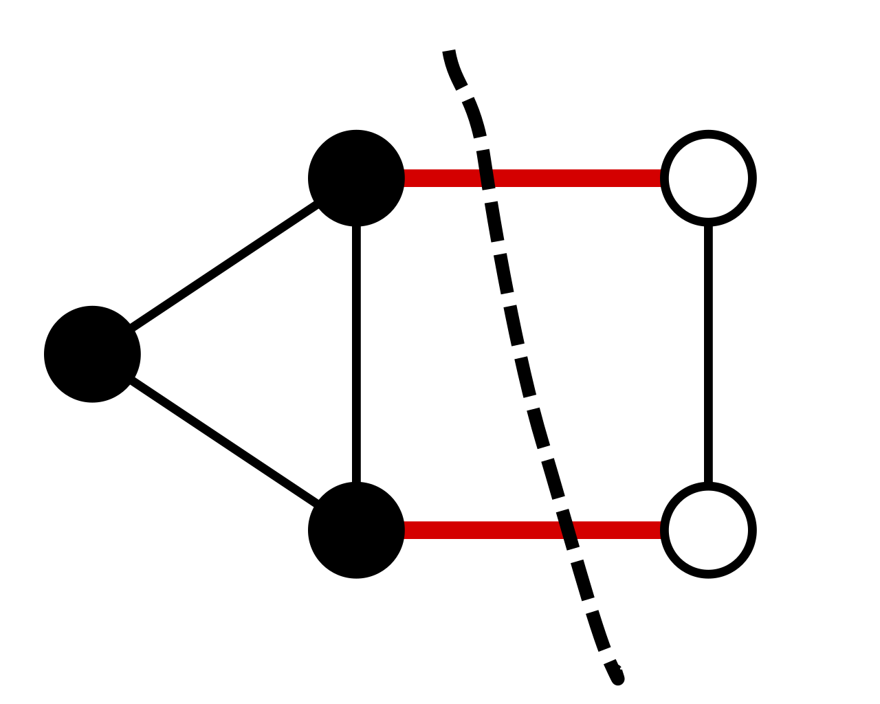
What is Maximum Cut?
A cut is a partition of the vertices of a graph into two separate or disjoint subsets. At the end we get a set called cut-set which consists of the edges that have one endpoint in each subset of the partition.
The maximum cut, as the name suggests, maximizes the number of crossing edges in an undirected graph. In other words, the size of this cut is not smaller than that of any other cut.

Slide 5
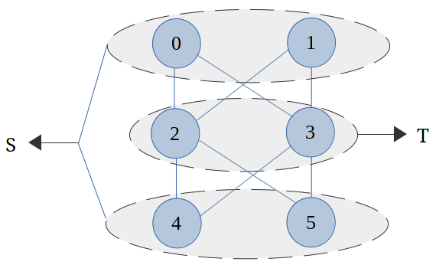
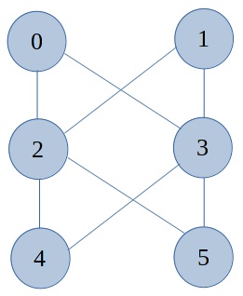
There are 6 vertices and 8 edges in the undirected graph
The maximum cut of the graph is 8

Slide 6
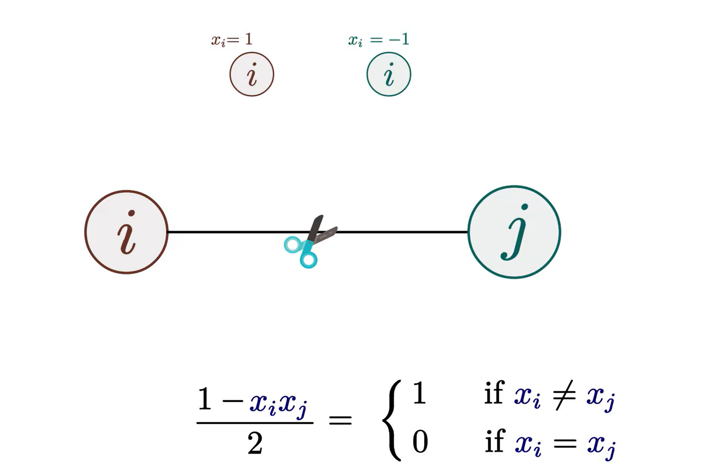

Problem Presentation

Slide 7
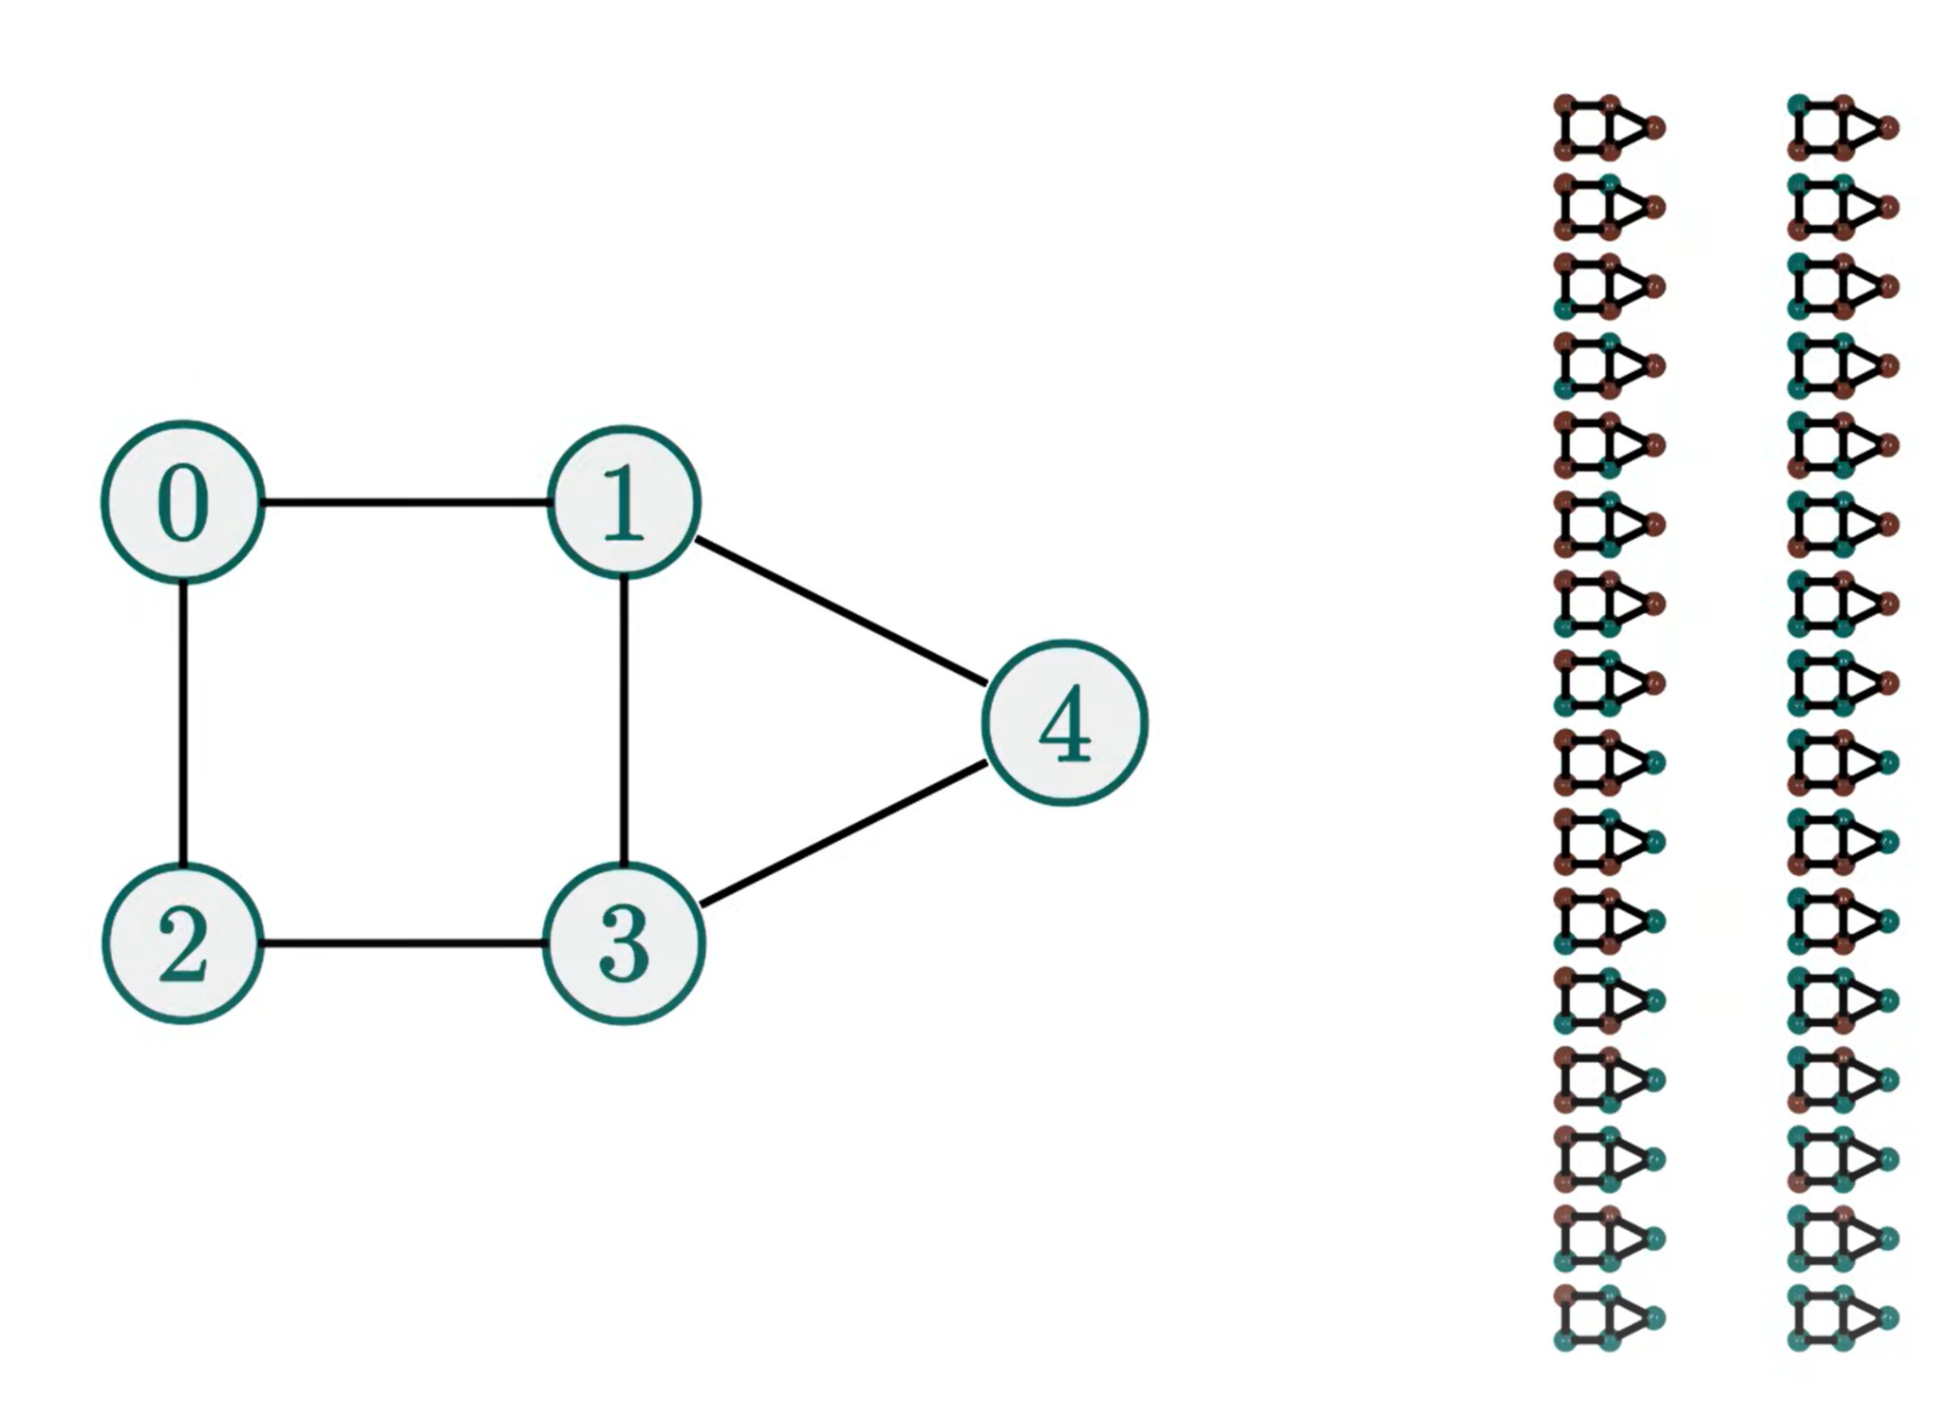
How to Solve?
Brute Force: Enumerate All possible color combination and find one that maximizes the cut!
Exponential Runtime - 2^{n}
NP Complete.

Slide 8
Polynomial Time Reductions

Slide 9
Independent Set ≤_{P} Maximum Cut
Assume, we have a blackbox that can solve the maximum cut problem. We wish to solve the independent set problem.
If G=(V, E) contains an independent set I ⊆ V such that |I| ≥ k, then there exists a cut in graph G’ such that |𝜹(S)| ≥ k+4.|E|

Slide 10
x
e
u
v
u
v
G_{e}
G
u_{e}
v_{e}
G’

Slide 11
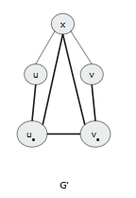
Start with S = I
Then for every edge e={u, v} 𝟄 E, do the following:
If u 𝟄 I and v ∉ I, then add v_{e} to S. Similarly, if u ∉ S and v 𝟄 S, then add u_{e} to S. Either way, exactly 4 out of 5 edges of G_{e} are cut
If u, v ∉ I, then add u_{e} and v_{e} to S. Again, exactly 4 out of 5 edges of G_{e} are cut
The case where u, v 𝟄 I is not possible because I is an independent set while {u, v} is an edge
For every w 𝟄 I, the edge {x, w} is cut by S. Also, for every edge e={u, v} 𝟄 E, exactly four gadget edges of G_{e} are cut. Thus number of edges cut by S is k+4.|E|
Thus, when an instance G=(V, E) and an integer k is passed through a blackbox solving Maximum Cut and asked whether a cut of size k+4.|E| exists, if the reply is “yes”, then the instance G has an Independent Set of size at least k.

Slide 12
Maximum Cut ≤_{P} Independent Set
Assume, we have a blackbox that can solve the independent set problem. We wish to solve the maximum cut problem.
Again, if a cut S exists in G’ such that |𝜹(S)| ≥ k+4.|E|, then there exists an independent set I ⊆ V such that |I| ≥ k

Slide 13
Without loss of generality, we assume that x ∉ S because otherwise, we can swap S and V\S without affecting the cut value
Let I be the subset of S corresponding to vertices in G, and suppose I is not an independent set. Consider any edge e = {u, v} 𝟄 E. If u, v 𝟄 S(i.e., { u, v} 𝟄 E),then we can see that S cuts at most three edges of G_{e}. In all other cases (at least one of u, v is not in S), we saw a way for S to cut four gadget edges. Thus, letting m(I) denote the number of edges within I, we have:
|𝜹(S)| ≤|I| + 3 . m(I) + 4 . (|E| - m(I)) = |I| + 4 . |E| - m(I)
Since |𝜹(S)| ≥ k + 4 . |E|, this implies |I| ≥ k + m(I). Thus, for each edge within I, we can “afford” to remove one of its endpoints from I to decrease the value of m(I) by one. After doing this at most m(I) times, we are left with an independent set of size at least k, as desired
Thus, when an instance G=(V, E) and an integer k is passed through a blackbox solving Independent Set and asked whether an independent set of size at least k exists, if the reply is “yes”, then the instance G has a maximum cut S such that |𝜹(S)| ≥ k+4.|E|.
3-SAT → NAE 4-SAT → NAE 3-SAT → Maximum Cut

Slide 14
Existing Algorithms

Slide 15
Exact Exponential Algorithms
Brute Force: Enumerating all possible partitions and selecting the one with the maximum cut. Practical only for small graphs due to its exponential time complexity. This algorithm gives time complexity of O(2^n).

Slide 16
Approximation Algorithms
Goemans-Williamson Algorithm: Based on semidefinite programming, it provides a polynomial-time approximation guarantee for the maximum cut problem. It provides approximation ratio of 0.87%.
Randomized Rounding: Using linear programming relaxation and rounding techniques to obtain and approximate solution
Spectral Partitioning: Using eigenvalues and eigenvectors of the graph’s adjacency matrix to approximate the maximum cut

Slide 17
Randomized Algorithms
Randomized Local Search: Iterative improvement by exploring neighbouring solutions randomly and accepting moves that improve the cut until convergence.
Simulated Annealing: A probabilistic technique mimicking the annealing process in metallurgy, allowing some suboptimal moves initially to escape local optima

Slide 18
Heuristic Algorithms
Greedy Max-Cut: Iteratively assigning vertices to maximize the number of edges between the sets, starting with an arbitrary partition of two sets.
Kernighan-Lin Algorithm: A refinement heuristic that swaps pairs of vertices between sets to improve the cut iteratively

Slide 19
Metaheuristic Algorithms
Tabu Search: It guides a local search procedure using memory structures to avoid from revisiting recently explored solutions.
Genetic Algorithms: Using principles inspired by natural selection to evolve a population of solutions toward an optimal or near-optimal solution.

Slide 20
Implementation Experiments

Slide 21
Greedy Max Cut
The Algorithm :
Randomly assign each vertex to one of the two sets.
Iterate through the vertices one by one
For each vertex, move it to the opposite set of its neighbors in order to increase the number of edges across the cut.
Continue until you no longer find any vertex that can be moved to improve the cut
The resulting partition of vertices into two sets represents the approximate solution to the Max-Cut problem

Slide 22
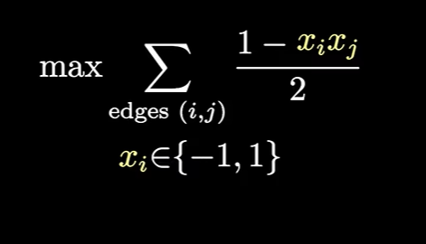
2. Goemans-Williamson Max-Cut Algorithm
1. Input: Graph G = (V, E) with weights w(e) for each edge e in E.
2. Solve the following semidefinite programming (SDP) relaxation:
3. Let X be the optimal solution of the SDP relaxation. (continue…)

Slide 23
2. Goemans-Williamson Max-Cut Algorithm
4. Perform a "random rounding" step:
For each vertex i:
Generate a random vector r_i in R^d (usually, d is set to a small constant).
Set the ith component of the vector v_i to be the corresponding row of X, i.e., v_i = X_i.
For each edge (i, j):
Let s_ij be the dot product of v_i and v_j.
If s_ij is greater than or equal to 0, assign both i and j to the same set.
Otherwise, assign i and j to different sets.
5. Output the resulting partition of the vertices.

Slide 24
Experiments
Comparison with Optimal Solutions:
Known Optimal Solution
Benchmark Instances
Compare cut quality
( Approximation Ratio )
Our Chosen
Algorithms

Slide 25
Experiments
Performance Evaluation By Varying Graphs
Generate different graphs varying their size, degree distributions , density , types of graphs (tree, grid etc), weight distribution etc
Measure & plot the runtime and cut quality for both of the algorithm for each variables.

Slide 26
Experiments
Performance on Real-world Networks:
Apply both algorithms to real-world networks (Maximum Response Time for ambulance, Machine learning binary classifications ) and measure the quality and runtime.

Slide 27
Theoretical and Real-world Applications

Slide 28
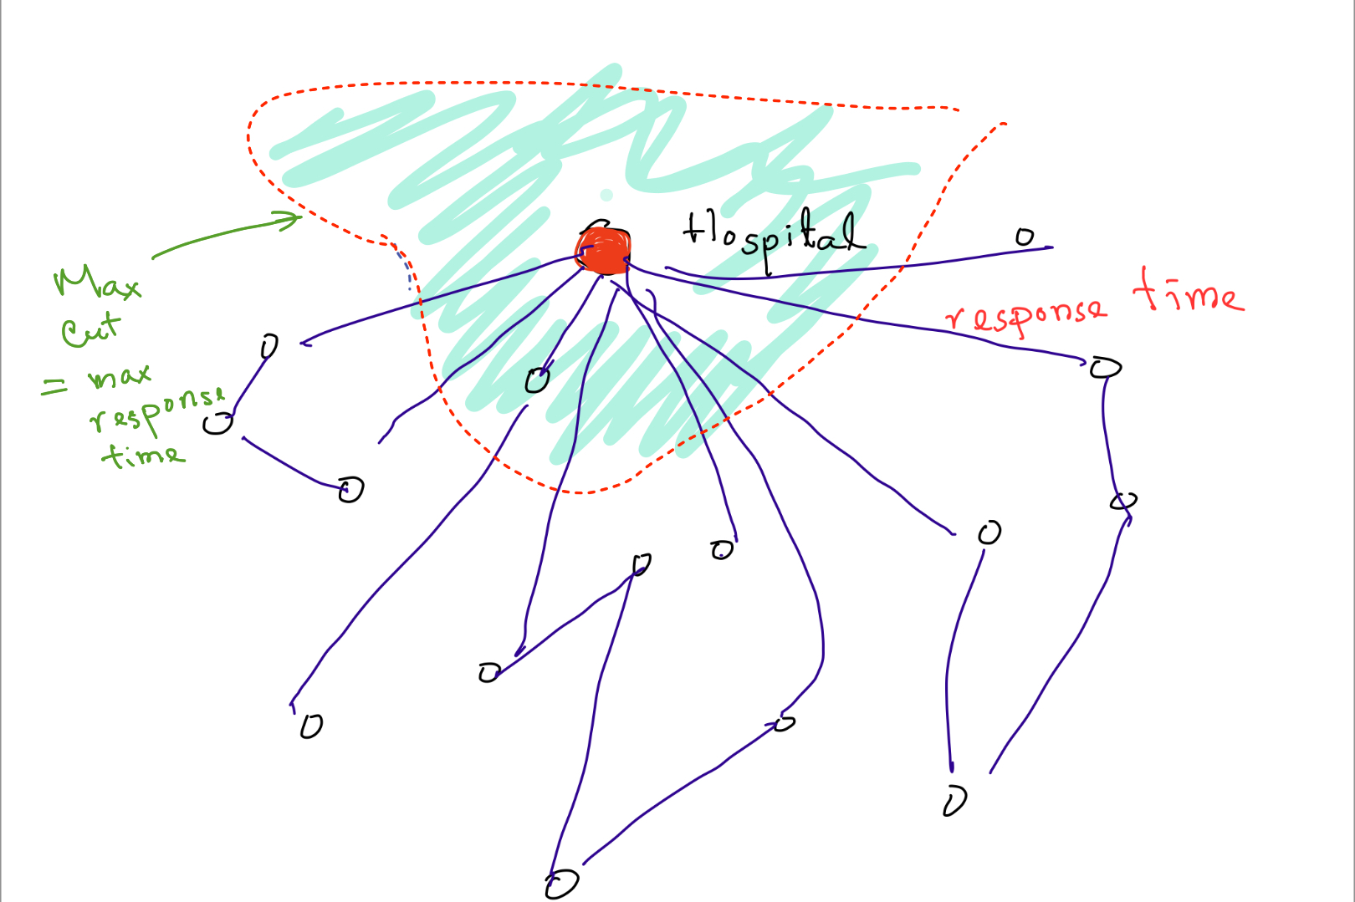
Use In Real World Application
Finding response time for ambulance

Slide 29
Binary classification
One group will be +1 and the other -1
No need for features only thing will be distance metrics

Slide 30
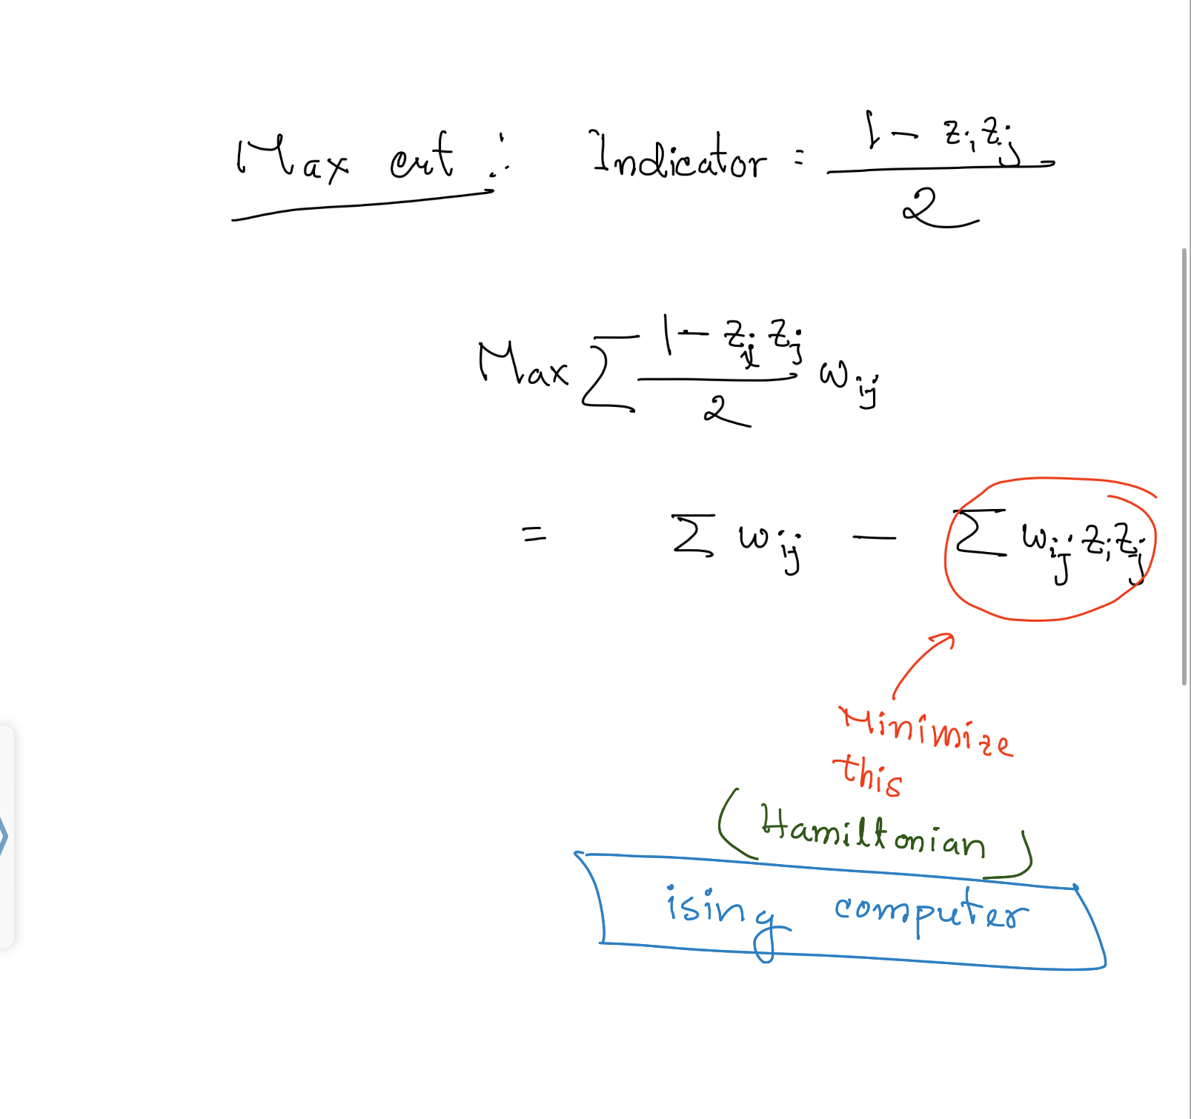
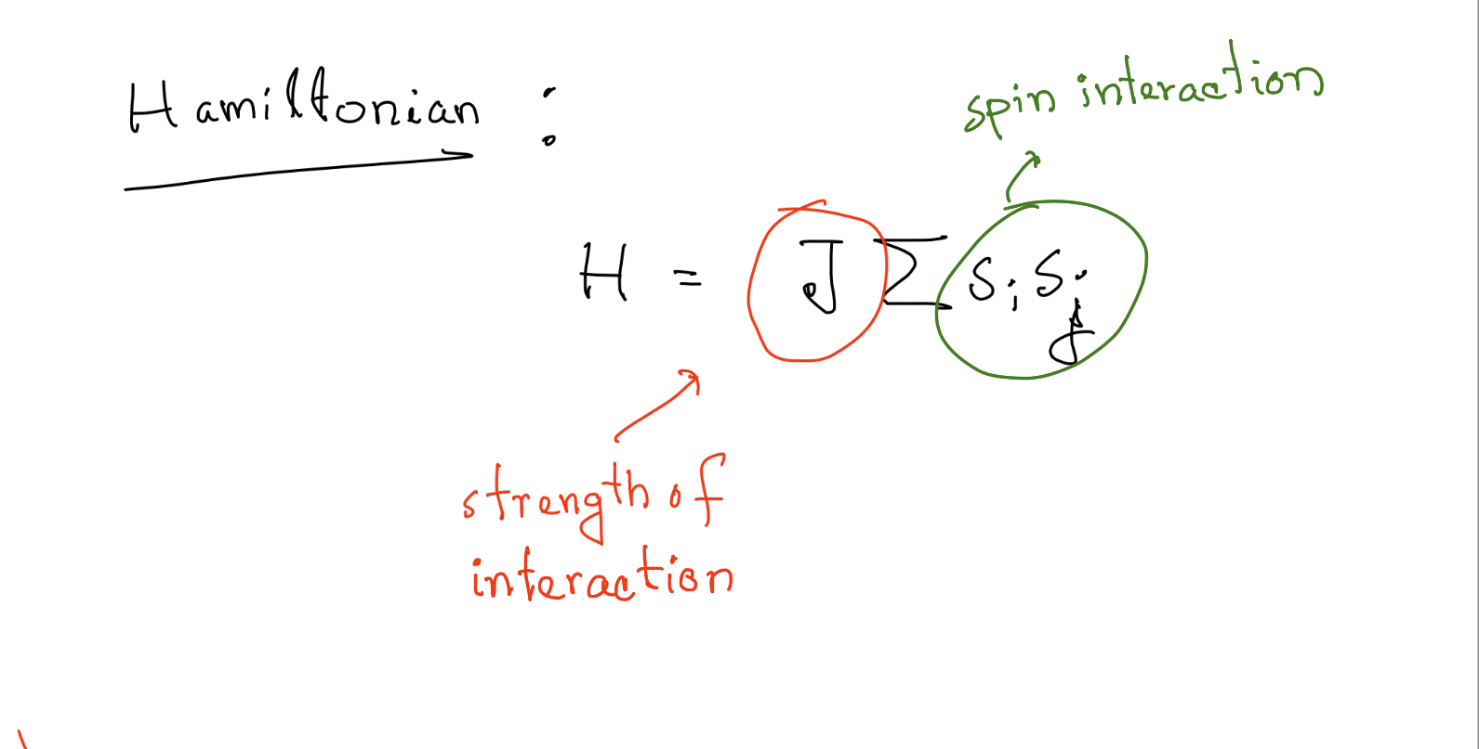
Theoretical physics

